Slide 1
Introduction to Air Quality
Lesson 1

Slide 2

Learning Objectives
Students will be able to ask questions, make observations, and analyze data to define a simple problem
Students will be able to explain air quality

Slide 3

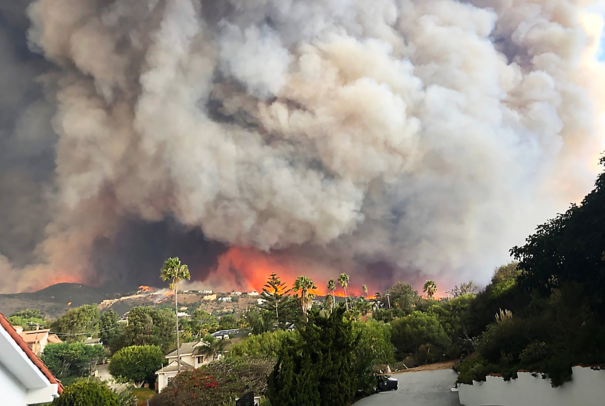

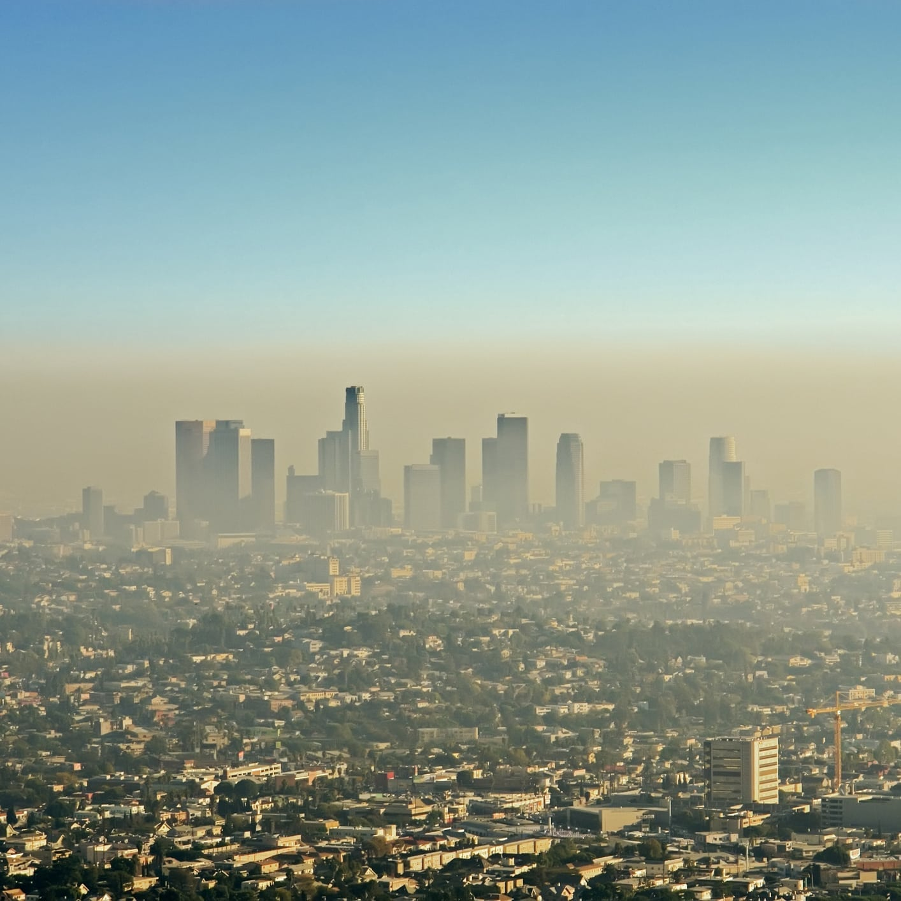

Think-Pair-Share
Do you think about the air you breathe?
​
Notes:
Students should write or circle three things that can be found in the air on the worksheet.

Slide 4
Clean Air For Everyone
Think About It
How might the air around us affect our health?
How do our bodies take in air? Where does air go when it is inside our bodies? Why does that matter?

Slide 5

Notes:
Stop at 1:27

Slide 6
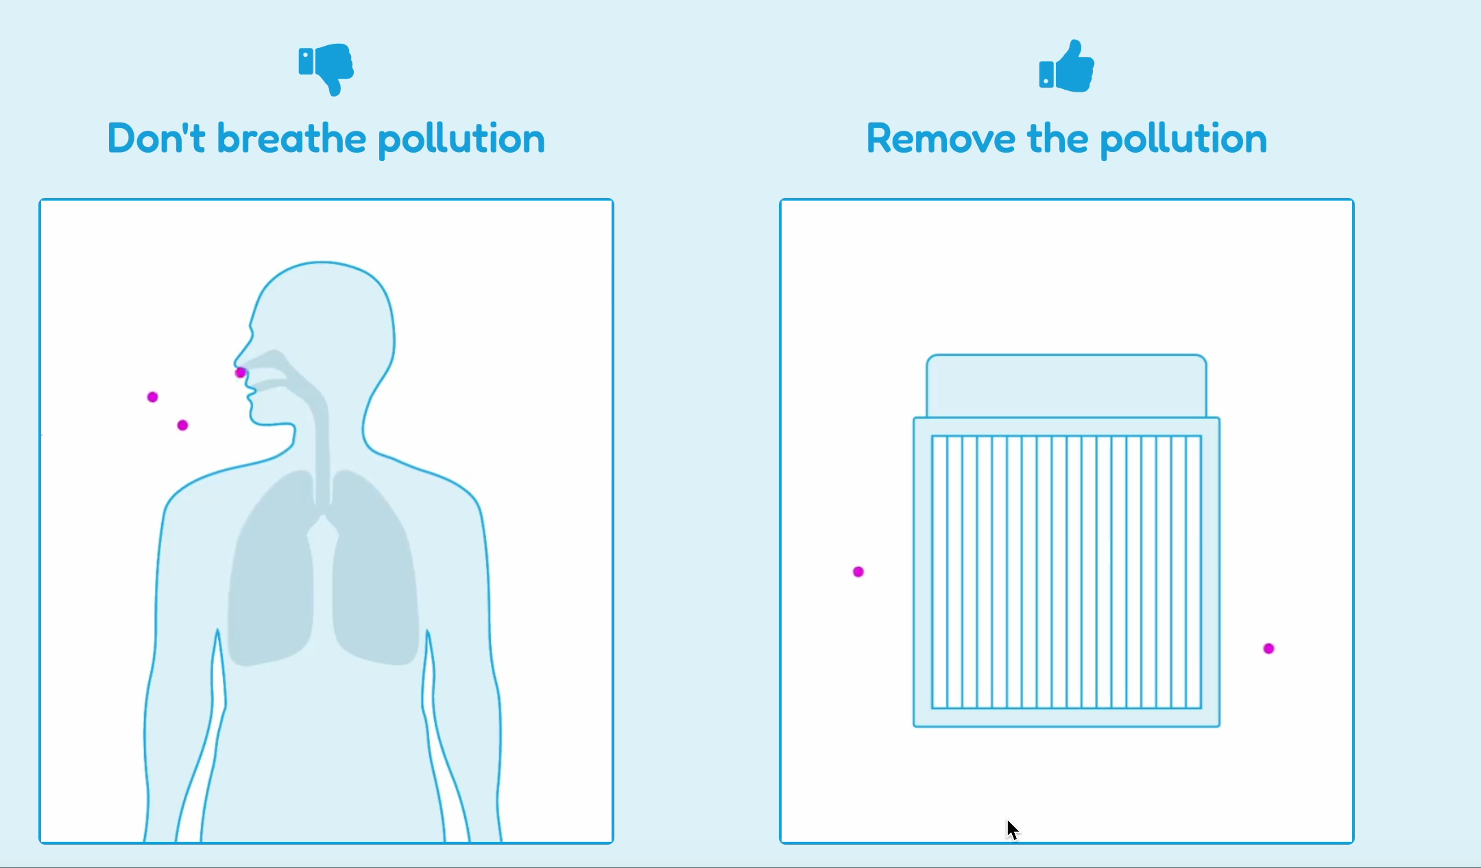
What do you notice? What questions do you have?

Slide 7
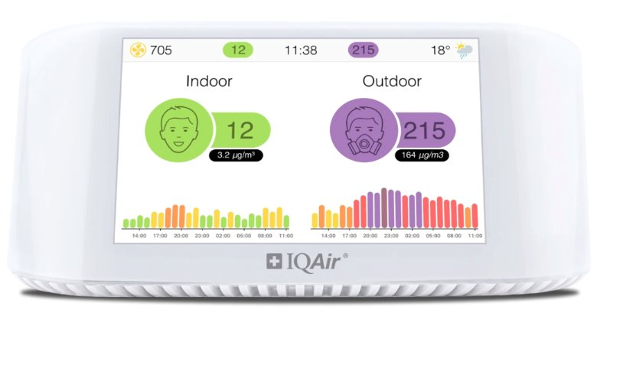
Predict: What is this device?

Slide 8
Air Quality Monitors and Index
Air Quality Monitor: measures the stuff in our air
Air Quality Index: report card for the air
What do you think the colors, faces, and numbers mean?

Slide 9

Exit Ticket: Turn and Talk
What was the problem we explored today?
What can we do as a class to solve the problem?

Slide 10
Observing an Air Purifier
Lesson 2

Slide 11
Learning Objectives
Students will be able to explain how the air purifier cleans air
Students will plan and carry out an investigation

Slide 12
Think Back…
What do you remember about air quality?

Slide 13
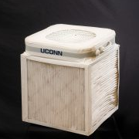
Tools help solve problems!
Observe:
What do you think this device does?
Notes:
Does it meet our criteria and constraints for cleaning the air?

Slide 14

How does it work?
How far can we hold the tissue where it will still get pulled towards the fan?

Slide 15
Exit Ticket
What is the purpose of the air purifier?

Slide 16
Analyzing Data
Lesson 3

Slide 17
Learning Objectives
Students will be able to analyze data to determine if a tool works
Students will be able to describe the trend in air quality over time

Slide 18
Think-Pair-Share
What does the air purifier do?
Can we tell if the air purifier is working?

Slide 19
Collecting Data
Write today’s date and the air quality index.
Draw a smiley or serious face.

Slide 20
What does the data tell us?
Write a sentence about your data.
Make sure to include evidence!

Slide 21
Exit Ticket
Who would want to know about your results?

Slide 22
Sharing Results
Lesson 4

Slide 23
Learning Objectives
Students will be able to communicate scientific information
Students will be able to argue with evidence in writing

Slide 24

Science Communication
- How do scientists communicate complicated information?

Slide 25
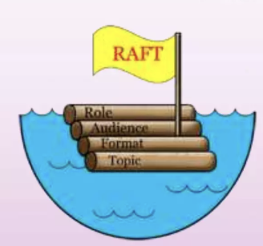
RAFT Activity and Worksheet
Role
Audience
Format
Topic

Slide 26
Gallery Walk
- Share your RAFT projects with your classmates!

Slide 27
Exit Ticket
How has your thinking about air quality changed?
I used to think ____. Now I think ____.

